Slide 1
Introduction to ITWS
Class Agenda for Sept 30
Quiz 1: Thurs Oct 3 during class
Term Project “Proposed Concept and Scope” due on Mon Oct 7 by end of day
Tech: Lab 4 due Oct 10 by end of day
Quiz 1: Review and Discussion
Applications: “Enterprise Applications”
“SAP and Cloud Computing in 2012 and Beyond” Case

Slide 2
Quiz 1 Preview
First Quiz on Thursday October 3
  All Technology, Applications, Case and Guest Speakers
  On laptop computers
  Open Notes, Open Internet
  No communication among students
  Full class time available
  Weight of Quiz (10% of Course Grade)
    Questions on Technology and Labs (1, 2, 3) (60%)
    Questions on Applications, Case (SAP), and Guest Speakers (40%)
Past Quiz 1 Example Posted on LMS

Slide 3
Introduction to ITWS is:
Introduction to Technology (applied Computer Science and applied Web Science)
  Protocols
  Programming
  Web design
  Database
Introduction to Applications
  Communication and Networking
  Social Networks
  Enterprise Apps (ERP, SCM, CRM)
  Web and Mobile Consumer Apps
  Healthcare and other Services
Intro to IT – Course Introduction

Slide 4
Concentrations associated with Enterprise Systems
Concentrations | Concentrations
Arts | Information Security
Civil Engineering | Machine and Computational Learning
Communication | Management Information Systems
Communication and Networks | Mechanical/Aeronautical Engineering
Computer Hardware | Medicine
Economics | Pre-Law
Electronic Commerce | Psychology
Entrepreneurship | Science and Technology Studies
Finance | Science Informatics
Industrial Engineering | Web Technologies

Slide 5
Enterprisewide Systems
ERP - designed to coordinate all the resources, information, and activities needed to complete business processes such as order fulfillment or billing.
CRM - software is used to support these processes; information about customers and customer interactions can be entered, stored and accessed by employees in different company departments.
Supply Chain Management (SCM) - is the management of a network of interconnected businesses involved in the ultimate provision of product and service packages required by end customers.
Notes:
Discuss examples & uses of each. How are each important to achievement of corporate goals?
Manufacturing has need for raw materials but maintaining, counting, ordering inventory is laborious & can be inaccurate; stock-outs
may occur; payment for orders may be outside good business practices (such as within time for cash discount). Utilizing the
common functions within most ERP, inventory levels are monitored electronically thru the use of RFID technology, orders occur
as needed, invoices are generated, payment occurs automatically based upon established payment terms, and shipments are made automatically
so that production schedules can continue as predetermined without interruption.
CRM software is used for collecting customer data so that data mining can be performed to determine current & future need trends. Utilizing
the software, specials can be pushed to appropriate customers only; credit terms can be predetermined & monitored for effectiveness. CRM
helps representatives to know & maintain relationships with customers about what is most relevant to the customer & to the organization.
All of these systems allow for KM processes to be used effectively by making the data available to those with a need to know.

Slide 6
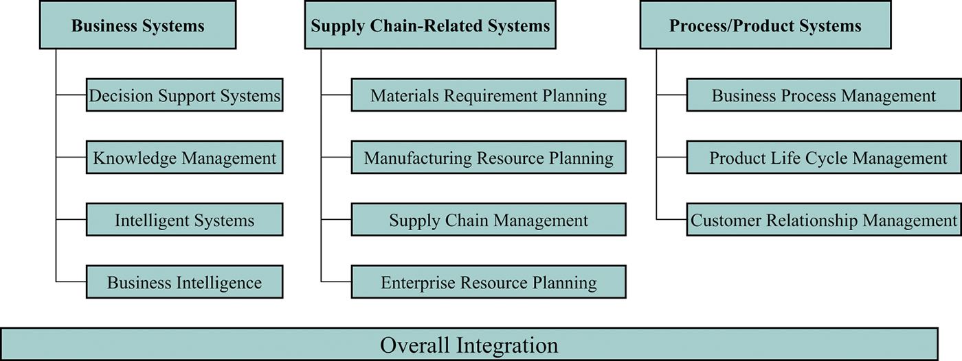
Notes:
DSS – purpose is to support decision making throughout the enterprise, frequently with the help of a data warehouse.
KM – object is to support knowledge creation, storage, maintenance & distribution throughout enterprise.
Intelligent Systems – include a knowledge component, such as expert system or neural network.
BI – computer-based decision analysis usually done online by managers & staff. Includes forecasting, analyzing alternatives, &
evaluating risk & performance.
SCM – efficient management of supply chain end-to-end processes that start with the design of product or service & end when sold,
consumed, or used by the end customer. Some activities include inventory management, materials acquisition, & transformation
of raw materials into finished goods, shipping, & transportation. Goal is to reduce uncertainty, variability & risks; increase control
in the supply chain, thereby positively affecting inventory levels, cycle time, business processes & customer service. Benefits
contribute to increased profitability & competitiveness.

Slide 7
What is ERP?
Software integrates planning, management & use of all resources in entire enterprise.
Comprises sets of applications that automate back-end operations (financial, inventory management & scheduling).
Modules for cost control, accounts payable/receivable, treasury management & fixed assets.
Benefits range from increased efficiency to improved quality, productivity & profitability.

Slide 8
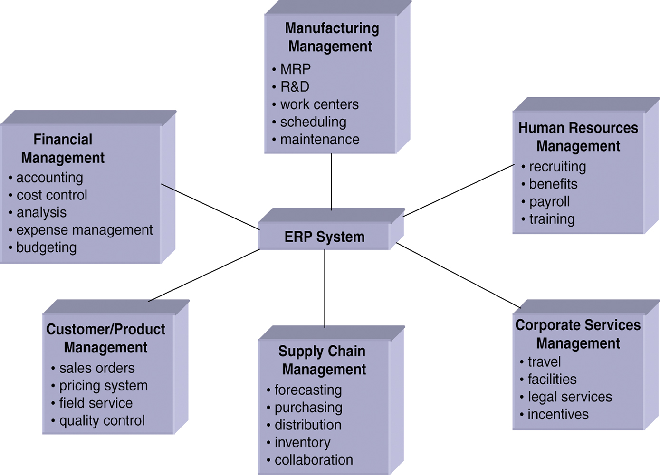
Notes:
According to wikipedia.org:
An application service provider (ASP) is a business that provides computer-based services to customers over a network. Software offered using an ASP model is also sometimes called On-demand software or software as a service.
Discuss advantages of integrated ERP such as SAP. The major objective of ERP is to integrate all departments & functional information flows
across a company onto a single computer system that can serve all of the enterprise’s needs.
SAP is already developed & can be adapted to almost any organizational systems. Quicker & generally less expensive than creating one
in-house. Another alternative is to lease applications

Slide 9
Supply Chain
Supply chain refers to the flow of materials, information, payments, and services from raw material suppliers, through factories and warehouses (Value Chain), to the final consumer (Demand Chain). It includes tasks such as purchasing, payment flow, materials handling, production planning & control, logistics & warehousing, inventory control, and distribution.
Supply Chain Flows
  Materials flows are all physical products, new materials, and supplies that flow along the chain.
  Information flows relates to all data associated with demand, shipments, orders, returns and schedules.
  Financial flows include all transfers of money, payments, credit card information, payment schedules, e-payments and credit-related data.

Slide 10
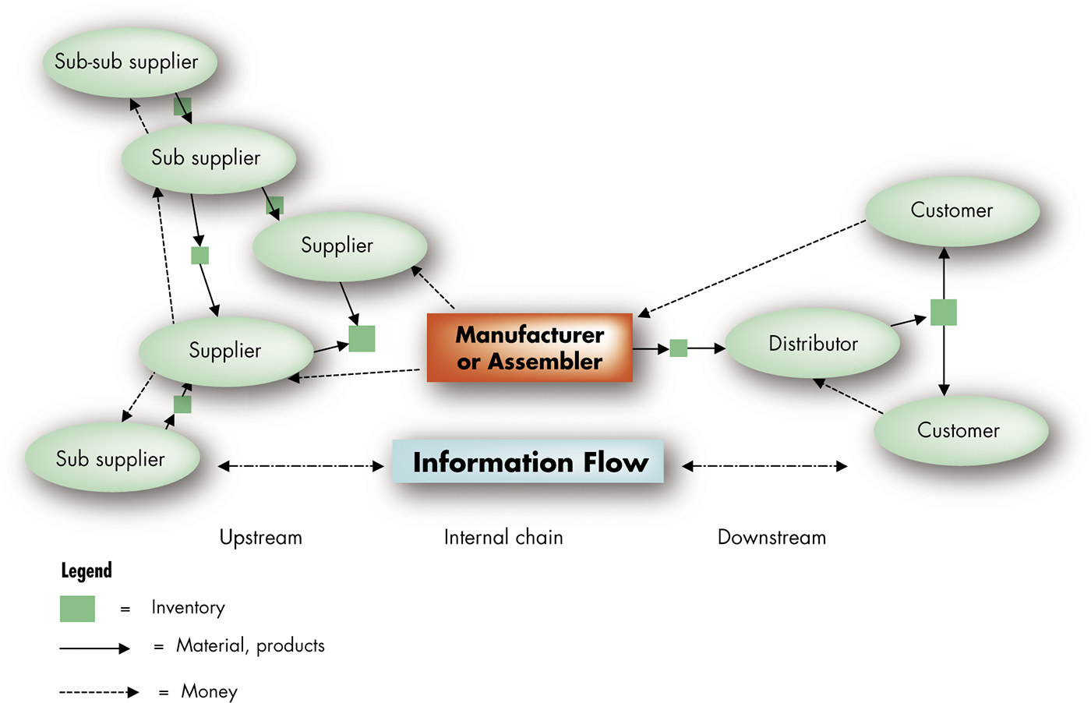

Slide 11
E-Commerce and Supply Chains
A major role of EC is to facilitate buying and selling along all segments of the supply chain.
Upstream Activities improve the upstream supply chain through e-procurement
Internal Supply Activities from entering purchase orders, to recording sales, to order fulfillment, to tracking shipments, are usually conducted over a corporate intranet
Downstream Activities enhance the activity downstream activities by providing online ordering
Vertical exchanges combine upstream and downstream EC supply chain activities. These B2B exchanges, provide a medium where buyers and sellers can meet.

Slide 12
Customer Relationship Management CRM Activities
Customer Service on the Web
  Search and Comparison Capabilities
  Free Products and Services
  Technical and Other Information and Service
  Allowing Customers to Order Products and Services Online
  Letting Customers Track Accounts or Order Status
Tools for Customer Service
  Personalized Web Pages
  FAQs
  Chat Rooms
  E-Mail and Automated Response
  Call Centers
  Troubleshooting Tools
  Wireless CRM

Slide 13
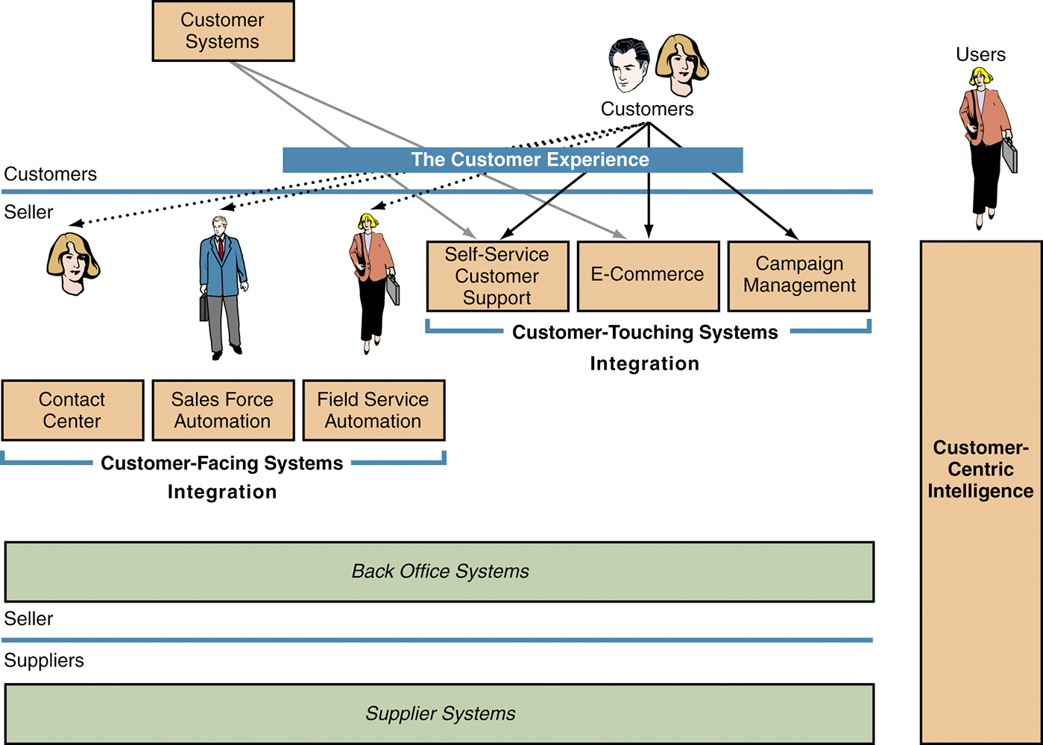
Notes:
Discuss for better understanding the marketing, management, operational perspectives addressing commonalities & where they diverge.
Core concept that recognizes customers are the core of the business & that the company’s success depends on effectively managing
relationships with them.
CRM is a business strategy to select & manage customers to optimize long-term value. Requires a customer-centric philosophy &
culture to support the philosophy effectively corporate-wide.
All decision are made thru & keeping in mind that the strategy is customer-centric, customer focused. Customers are treated
differently because they have different needs & different value to the firm.

Slide 14

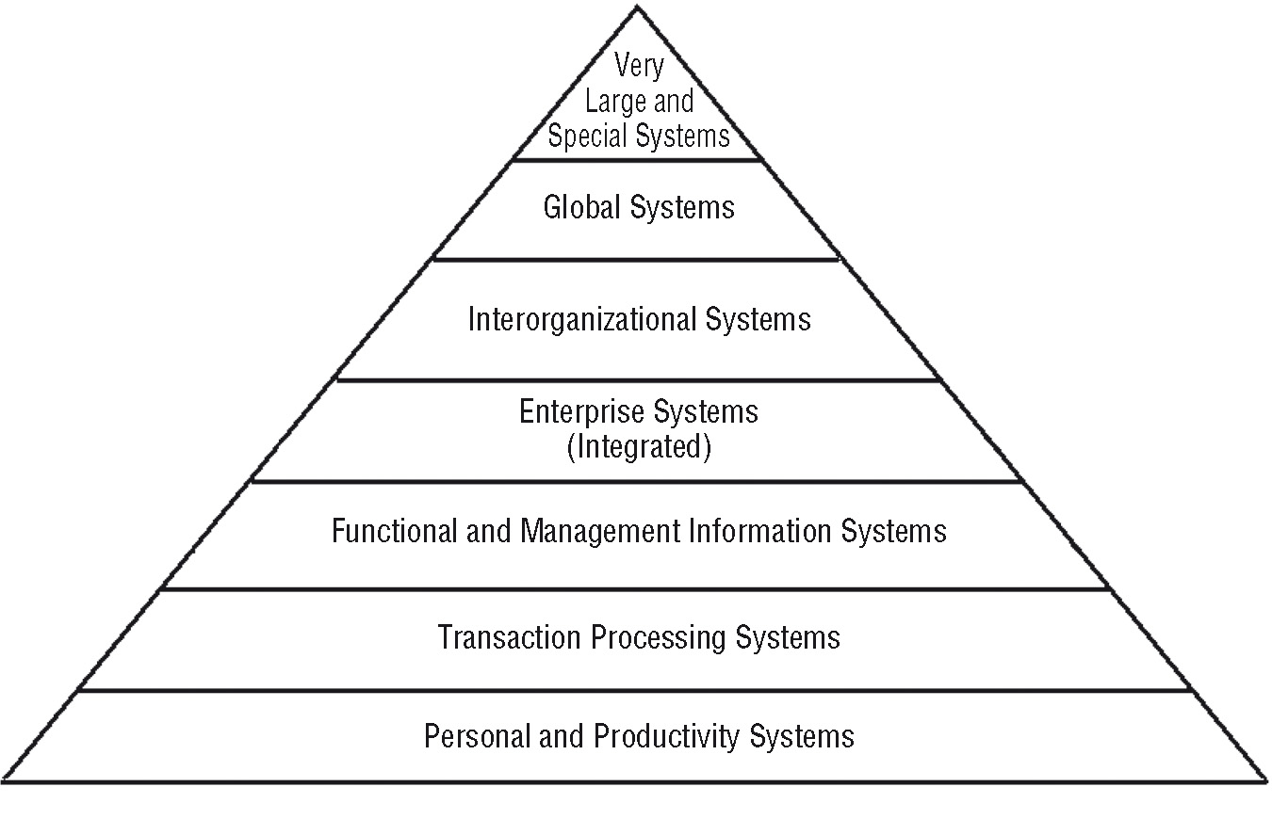
Levels of Information Systems

Slide 15

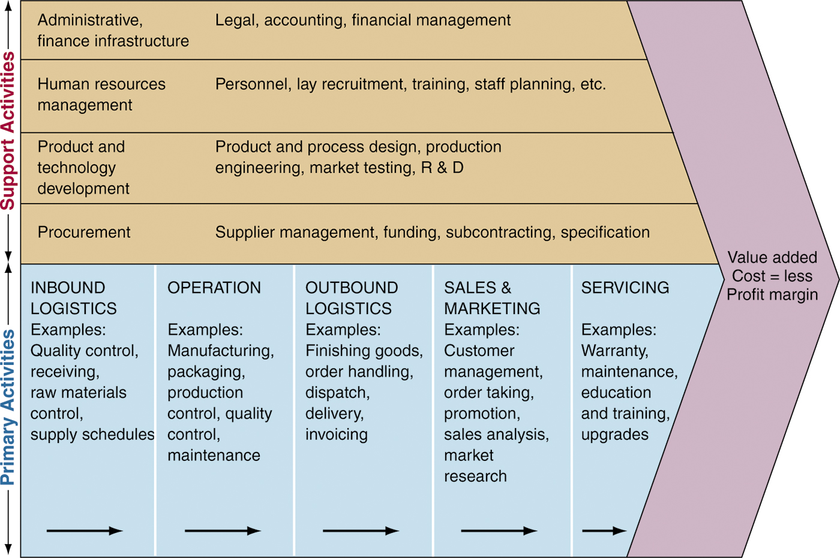
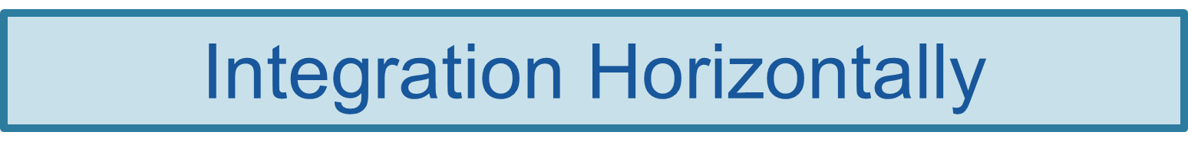
Porter Value Chain Diagram

Slide 16

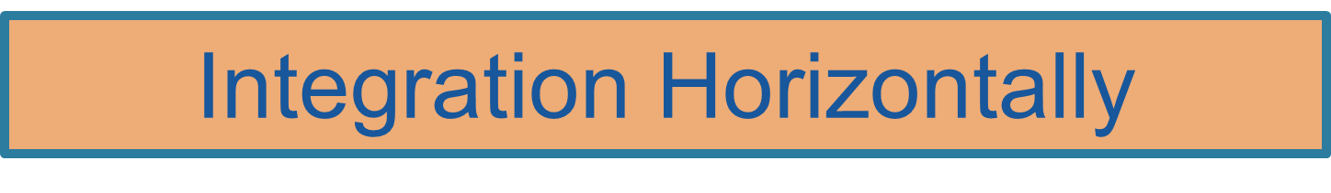

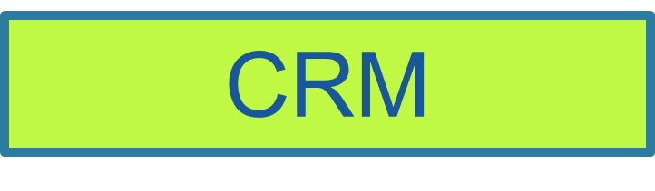
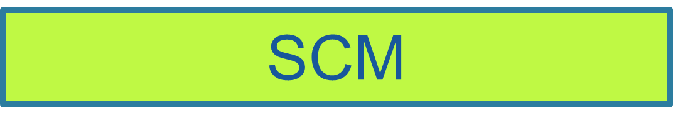
Supply Chain Analysis
Suppliers
Contract
Production
Company
Channel
Customers
Semi-conductor
Retail
Consumer
Enterprise
CMO - Asia
HW
VAR/SI
Enterprise
CMO -NA
SW
Distrib
Gov’t

Slide 17
“SAP and Cloud Computing” Case
What are “Enterprise Apps”?

Slide 18
“SAP and Cloud Computing” Case
What is “Enterprise Resource Planning (ERP)”?

Slide 19
“SAP and Cloud Computing” Case
What is “Cloud Computing”?

Slide 20
“SAP and Cloud Computing” Case
What are the three types of Cloud Computing and how do they differ?

Slide 21
“SAP and Cloud Computing” Case
What are several important “Technologies” of the “Cloud”?

Slide 22
“SAP and Cloud Computing” Case
What are several important “Applications” of the “Cloud”?

Slide 23
“SAP and Cloud Computing” Case
What are the advantages of “Cloud Computing” for “Enterprise Resource Planning”?

Slide 24
“SAP and Cloud Computing” Case
What are the advantages of purchased “ERP Software” for “Enterprise Resource Planning”?

Slide 25
“SAP and Cloud Computing” Case
How does the “Revenue Growth Rate” of “ERP Software” compare with the “Revenue Growth Rate” of “Cloud Computing Enterprise Applications”?

Slide 26
“SAP and Cloud Computing” Case
How does the “Net Profit Margin” of the vendors (SAP, Oracle) of “ERP Software” compare with the “Net Profit Margin” of the vendors (Salesforce.com, SuccessFactors.com) for “Cloud Computing Enterprise Applications”?

Slide 27
“SAP and Cloud Computing” Case
What will SAP’s relative market share for “Cloud Computing for ERP Applications” be in three years? Choose one of the following options:
  1. SAP will have the highest market share among all vendors of “Cloud Computing for ERP Applications”?
  2. SAP will offer “Cloud Computing for ERP Applications” but other vendors will have higher market share than SAP.
  SAP will exit the “Cloud Computing for ERP Applications” market and concentrate on purchased “ERP Software”.
Give 4 reasons for the answer above.

